Slide 1

Housing Dataset

Slide 2
DESCRIPTION
This dataset is the compilation of data about features of the houses and their selling price. In our dataset the target column is Sale Price.
The other feature columns include House Style(No of floors in a house), Central Air(if the house if air conditioned or not), Fire places etc. These are features that affect SalePrice.
Number of Columns in the dataset:
Before Data Cleaning:
Categorical- 43
Numerical- 38
After Data Cleaning:
Catergorical-18
Numerical-28

Slide 3
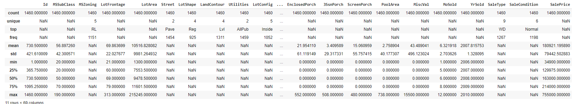
Data Description

Slide 4
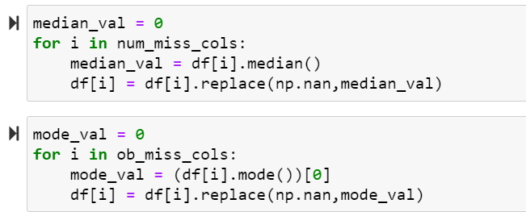
NULL VALUES TREATMENT
For those columns whose null value percentage was greater than 35%, we treated them by dropping the entire column. These columns were:
To the data columns that remained, we performed these steps to treat the missing and null values.
For the categorical columns we found the mode of the data and replaced the missing values and similarly replaced the null values of the numerical data with the median of the data.

Slide 5
BOX PLOTS FOR NUMERICAL DATA
The numerical columns which had too many outliers have been dropped. The dropped columns are as follows. In the following slides are a few Box Plots of this data.
LotArea
BsmtFinSF2
LowQualFinSF
BsmtHalfBath
KitchenAbvGr
EnclosedPorch
3SsnPorch
ScreenPorch
PoolArea
MiscVal

Slide 6
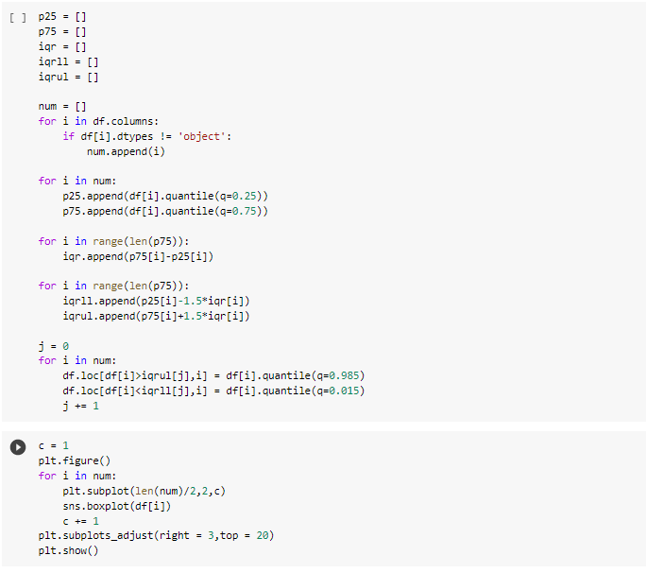
Box Plot
Here is a code snippet showing how we have plotted the graphs and dealt with the outliers.

Slide 7
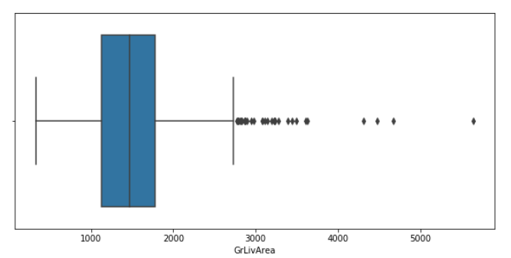
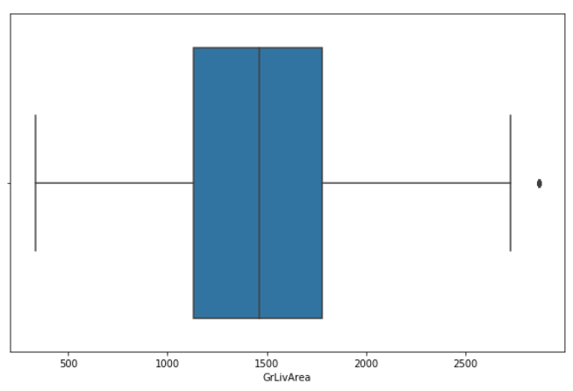
In the example below we have treated the outliers and the graphs show the drastic improvement in the data.
We have replaced the outliers here with the 98.5 and 1.5 percentile and hence the data is corrected.

Slide 8
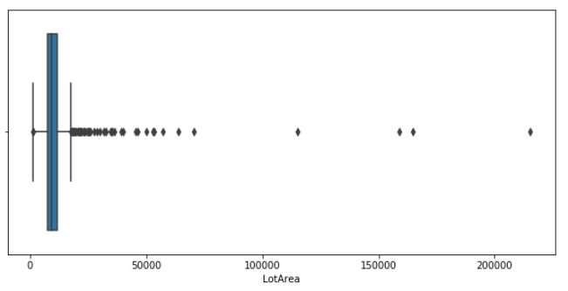
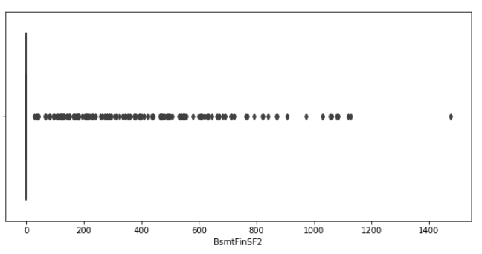
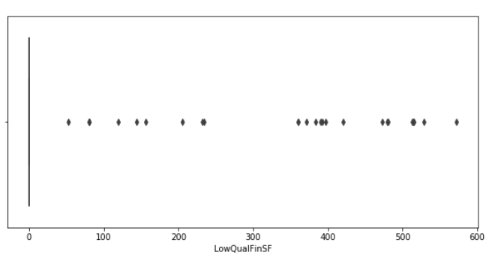
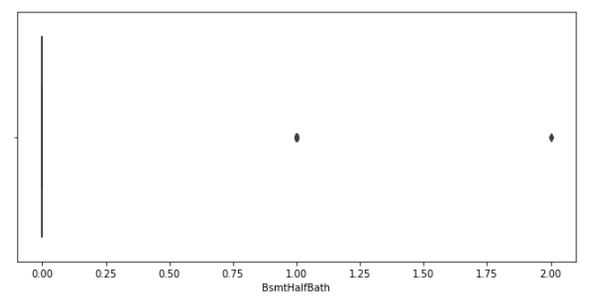
Some of the severely bad data filled with multiple outliers are shown below.

Slide 9
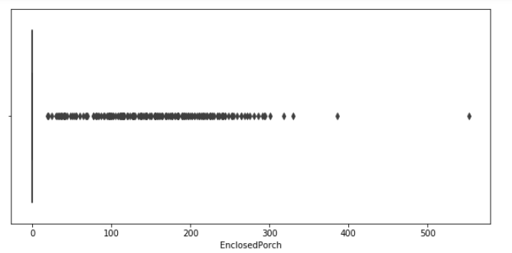
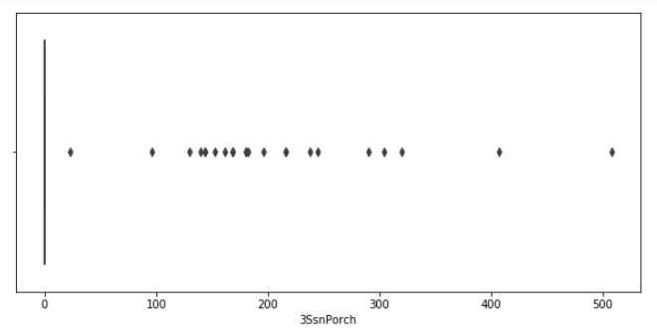
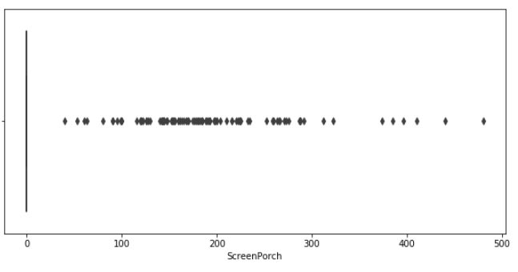
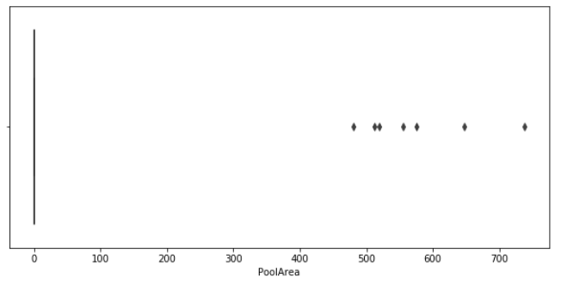

Slide 10
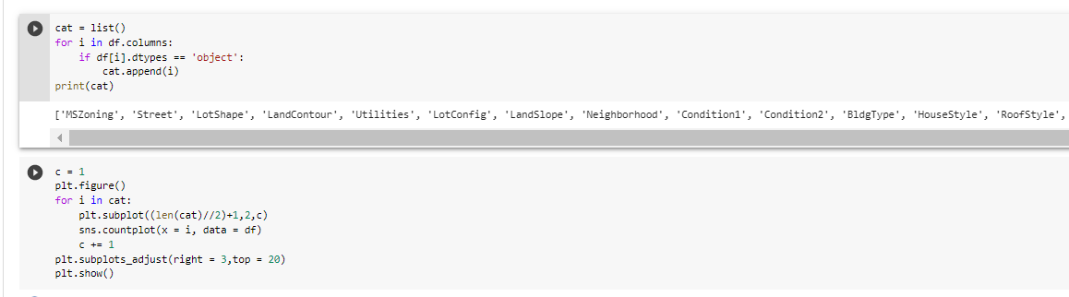
Bar Chart
Below is the way we have graphed the categorical data using bar chart. First we have listed all the data columns that are categorical data. After this we have plotted the bar graph to better visualize the data.

Slide 11
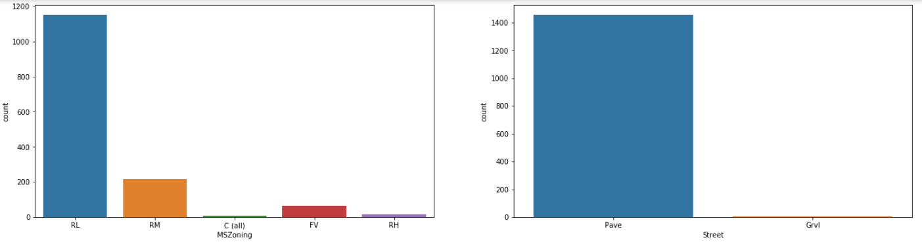
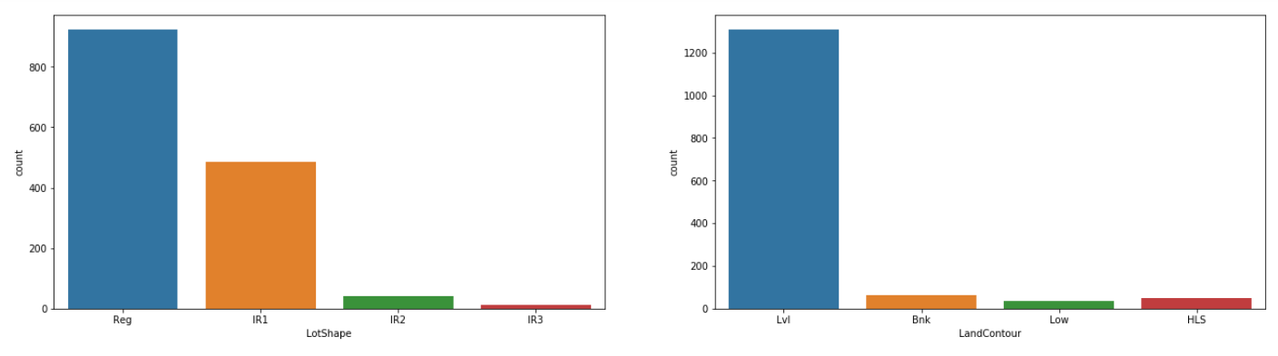
BAR GRAPH FOR CATEGORICAL DATA

Slide 12
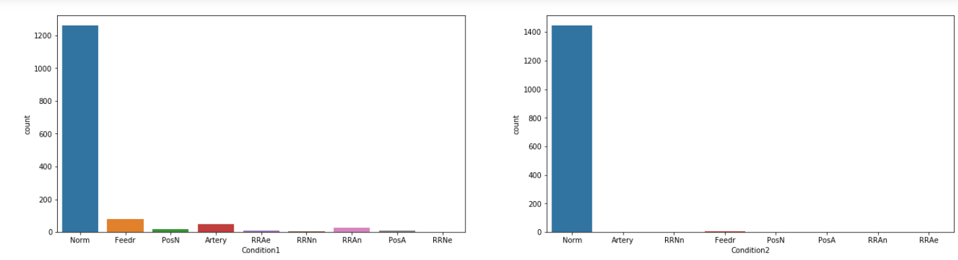
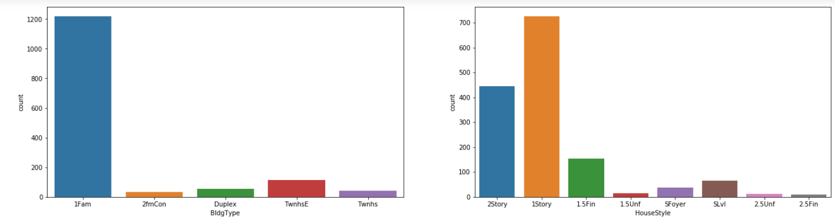
Examples of Bad Categorical Data in our Dataset

Slide 13
The list of categorical columns dropped because of their most of the values belonged to a single category and was not uniformly distributed :
'Street’,
'LandContour’
'Utilities’
'LandSlope’
'Condition1’
'Condition2’
'RoofMatl’
'ExterCond’
'Heating’
'Functional’
'PavedDrive’

Slide 14
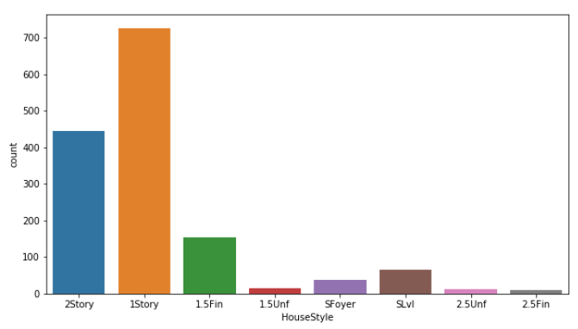
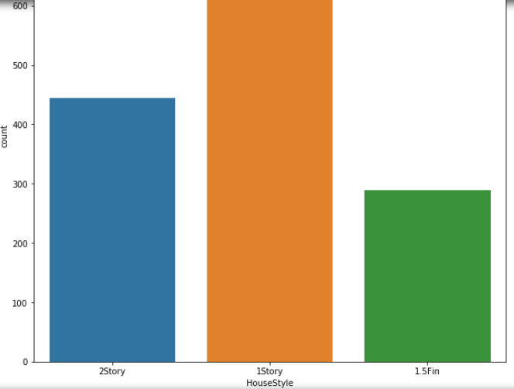
The columns that had multiple categories where only 2 or 3 categories had the most concentration of data we shifted the values from the other categories into the lesser of the 2 or 3 main categories. For example in the given data below, HouseStyle, only 2Story, 1Story, 1.5Fin categories have the most values as compared to the rest. So the remaining categories values were changed into 1.5Fin to make this data more cleaner and efficient.
Before
After

Slide 15
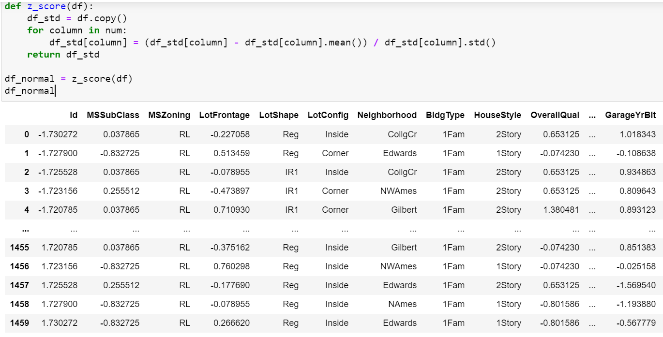
NORMALIZATION
Using the Z-Score Method, we normalized the Numerical Data to have a mean of 0 and Standard Deviation of 1.

Slide 16
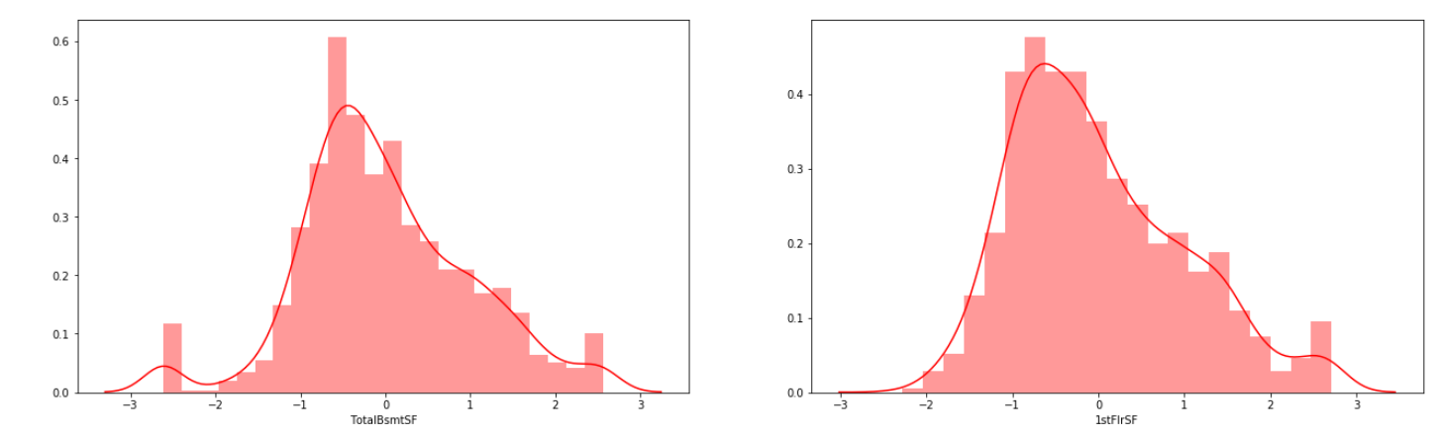
Graphs of Normalized Data

Slide 17
HYPOTHESIS TESTING
Question Framed:
In the given dataset ,for properties which had a sales price greater than 2,00,000 dollars, the mean value of the approximately normally distributed data, Ground Living Area (GvLivAr) was found to be 1965.33 sq meters. A sample of 50 properties were selected from this population whose mean was found to be 1930.14 and standard deviation equal to 388.12. The significance level(alpha) was assumed to be 0.05.
Null hypothesis: H0: Population Mean= 1965.33
Alternate Hypothesis: H’: Population Mean!= 1965.33
After performing the necessary tests, the value of p was found to be 0.99. This value was greater than the significance level we assumed earlier. Hence we failed to reject the Null Hypothesis.

Slide 18
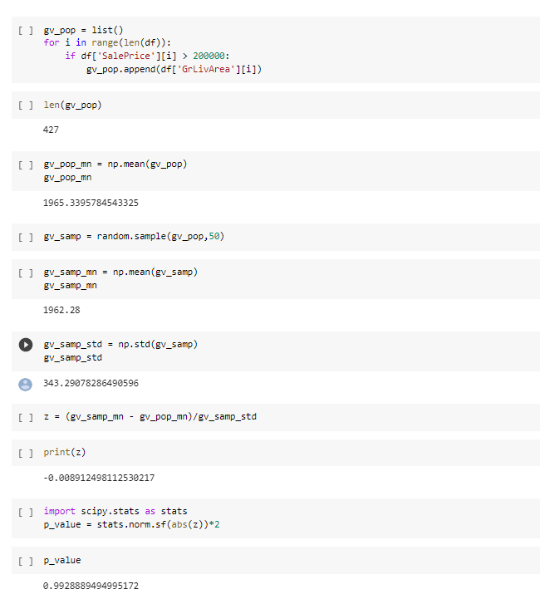
Using the techniques of Z testing and thereby finding the P values, we came to a conclusion that P=0.992
This P>0.05.

Slide 19
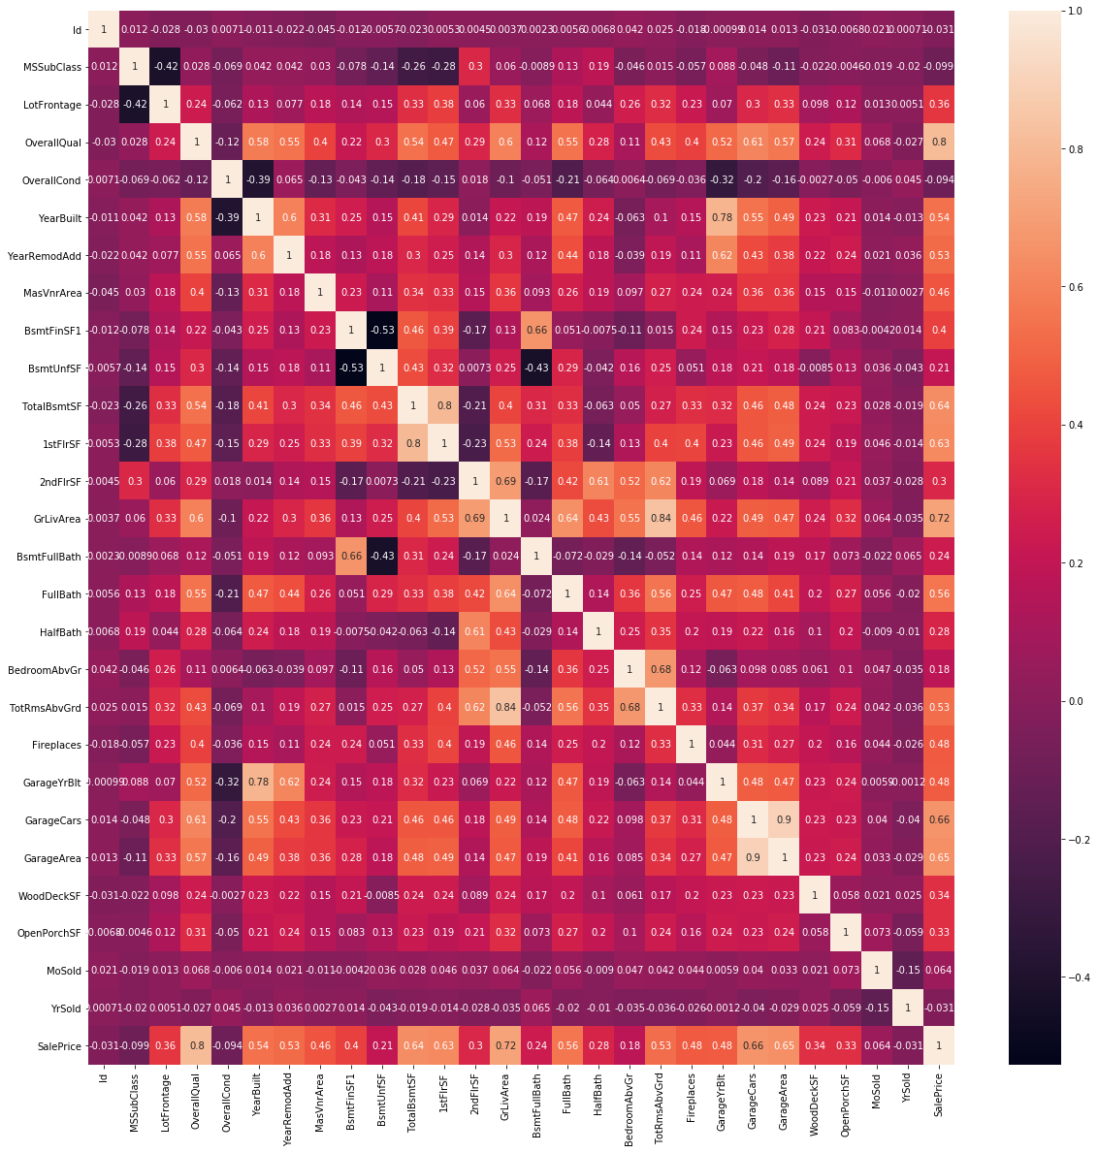
CO-RELATION USING HEAT MAP

Slide 20

Using the above heat map we were able to infer the co- relation between the variables in the dataset.
The boxes that were lighter in shade had a positive co- relation.
The boxes that were darker in shade had a negative co- relation.
For example, GarageYrBelt and OverallCondn was dark in shade and hence had a negative correlation.
Similarly, YearBuilt and GarageYrBuilt was light in shade and hence had a positive correlation.
Many such inferences can be made using this heatmap.
The code for this function is as follows:

Slide 21
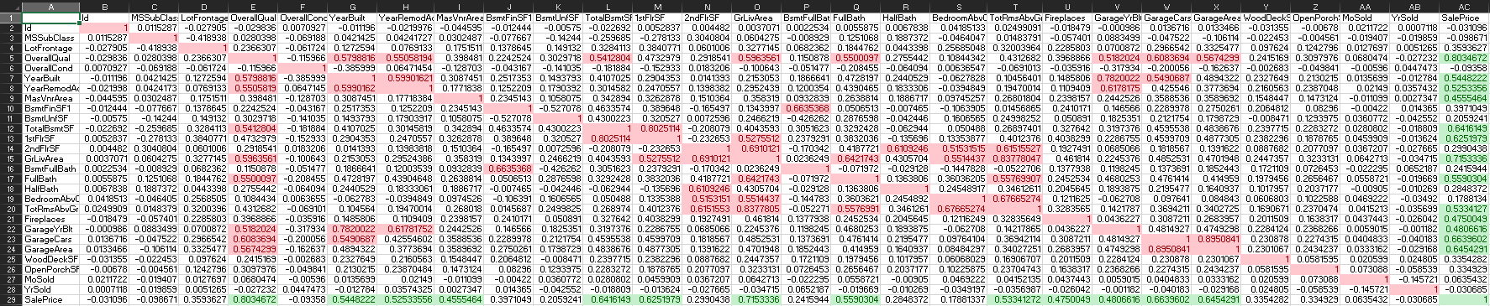
In the excel sheet here, we have highlighted those columns which are closely related to each other as well as the target column Sale Price.
The columns which are closely related to each other is highlighted in red and the columns which are closely related to the target column are highlighted in green.
For example the columns TotalBsmtSF and OverallQual were closely related to each other with the value of 0.541 and the Target Column SalePrice is closely related to OverallQual(0.803), YearBuilt(0.544), YearRemodAc(0.522) , etc.

